Slide 1
No Conflict of Interest to declare
I AM TEAM KENYA
#KENYAatAIDS2018

Slide 2
Notes from the field: implementation challenges and opportunities
Wanjiru Mukoma, PhD
wanjiru.mukoma@lvcthealth.org
www.lvcthealth.org
LVCT Health
#KENYAatAIDS2018
Notes:
Not a model, Considerations to advance the conceptual development of differentiated service delivery for prevention in the fast track era recognising that different models will work for different people and contexts

Slide 3
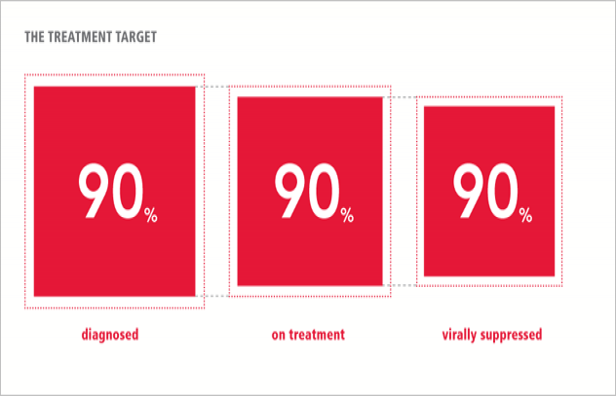
Stating the obvious
It is not just 90-90-90 but also 10-10-10; about 100%
The remaining % to access will require more effective approaches
Treatment alone will not get us there
It is not Treatment or prevention; it is Treatment and prevention
Primary prevention is grossly underfunded
#KENYAatAIDS2018

Slide 4
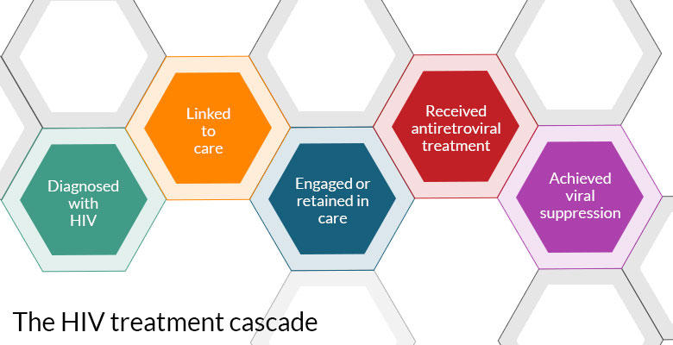
Treatment cascade is more developed
WHEN
Service frequency
WHERE
setting
Client
WHO
Service provider cadre
WHAT
Services offered & intensity
Differentiated service delivery model
#KENYAatAIDS2018

Slide 5
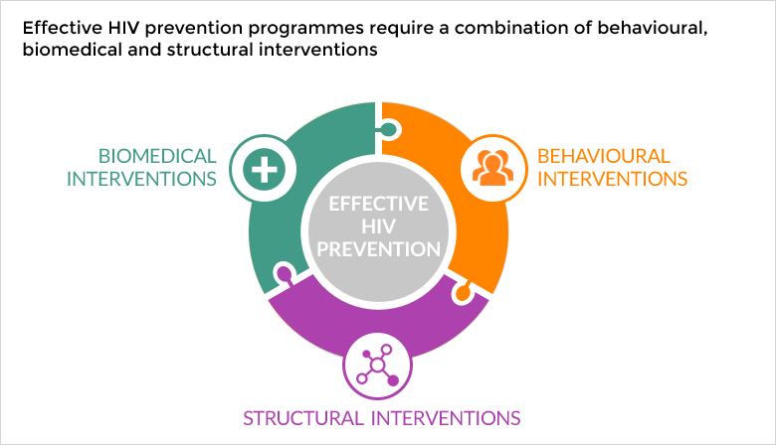
For Prevention

Slide 6
Combination prevention
advocacy
Stigma reduction
Biomedical
HTS, ART, PrEP VMMC, PEP, Post rape, STI screening and treatment, MAT, HPV vaccination,
Cancer screening
Free education
condoms
Decriminalization
Structural
Stigma & discrimination, economic empowerment, community norms, life skills training, GBV, condoms, alternative livelihoods, human rights protection, psychosocial support
Sanitary towels
Gender equality
Respect
Behavioural
Evidence based interventions, condom promotion, & use, needle exchange, substance use
Strong community systems
PrEP
Good laws
Strong health systems
#KENYAatAIDS2018

Slide 7
Differentiated service delivery for prevention
WHEN
Per guidelines
Per agreed schedule
Based on client risk
WHERE
Facilities – hospitals, clinics
Community service delivery centers
Virtual spaces
community-led Safe spaces
Client
WHO
Clinicians and other providers
Counselors
Peers
CHWs
WHAT
Basic Package for all
Basic package + additional (Group) based services

Slide 8
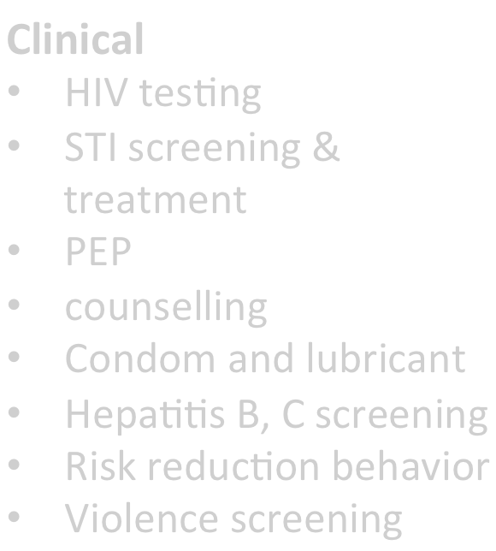

Differentiated service delivery for KPs
essential package for KPs
Essential package + LVCT Health
WHERE HOW
Clinical
Evidence based interventions Clinical services
ART initiation& reﬁll
Blood draws for lab tests
monitoring and creatinine
baselines ( PrEP)
Partner notiﬁcation services
FSW -Cervical cancer screening; Family planning
HIV testing
STI screening & treatment
PEP
counselling
•
•
•
•
Drop in Centres (DICEs)
Facility based
Only 21.5% of sexual minorities in Kenya visit a health care provider when they have sexual and reproductive health problems (NASCOP, 2016).
Condom and lubricant HepaBBs B, C screening Risk reduction behavior Violence screening
Service Providers
KP
prevention
program
Service providers
Service providers
Clinical Services
HIV tesBng & Self tesBng
STI & TB screening & treatment
PrEP iniBation & support
PEP
ART iniBation & reﬁll
Blood draws for lab tests
Partner notiﬁcation services
Post violence care
FSW-Cervical cancer screening ; FP
PWID -needle and syringe provision; hepaBBs B tesBng and vaccination; MAT
referral
Peer led approach for service uptake
Non Clinical
•Health education
•Condoms & lubricants
•Needle and
syringes
Out reaches
Snowball mobilization
Referral for clinical services
Outreach (hotspots & mobilisationvenues)
•Referral to clinical services
Evidence based internveitons Psychosocial support
Service Providers & Peers
Peers
Notes:
Pretty straight forward but why are we not getting prevention results and quickly enough? Why are people becoming HIV positive?

Slide 9
Key implementation challenges
People do not go to facilities for prevention but for a biomedical services
WHEN
Standard application of guidelines to all clients e.g. 3 monthly retesting of KPs
WHERE
Primarily HIV Service delivery sites/facilities
Weak community health systems
Poorly resourced community led initiatives
Services should be provided when needed
Prevention is intensive, out of sync with lifestyle
Community led interventions are underfunded
Client
Entry point is risk assessment – it changes
Weak synergy within and beyond health system
WHO
Provider bias
Narrow role of community
WHAT
Basic Package package for all
Group level differentiation
Biomedical approach to prevention
Supply driven Services
Individuals` prevention needs change
Weak/no clear leadership for prevention in national programs
Focus on number targets
#KENYAatAIDS2018

Slide 10
opportunities
Actualise prevention coalition 2020 roadmap
Develop prevention cascades
DSD approach
UHC
Funding for community systems and innovations
#KENYAatAIDS2018

Slide 11
Conclusion
People at the center
Examples of context specific good practices from communities
Flexibility- of providers, delivery mechanism, donors
Integration of services within and beyond health
Innovation
Improve provider capacities
The prevention of new infections will not be won clinics only, we must get the services to where people congregate, where they prefer, where they live and go about their daily live, understand and respond to their greatest prevention needs
#KENYAatAIDS2018

Slide 12
Thank you
www.lvcthealth.org
#KENYAatAIDS2018

